Slide 1

Union Management System
Automating Operations & Ensuring Transparency in Union Processes
Confidential | Project Overview 2024

Slide 2



PROJECT OVERVIEW
The Challenge
The Solution
Traditional union management relies on manual paperwork and opaque decision-making. This leads to administrative burden, lack of trust, and difficulty in compliance reporting.
A comprehensive web application that digitizes the entire lifecycle of union activities—from member registration to democratic voting and transparent financial tracking.

Slide 3






CORE OBJECTIVES
Transparency
Automation
Democracy
Open access to union health, funds, and decision-making processes for all registered members, building long-term organizational trust.
Reducing manual effort by automating member tracking, fee collection, and compliance reporting through a centralized cloud engine.
Ensuring every voice counts through a secure, tamper-proof digital voting mechanism for resolutions and leadership elections.

Slide 4
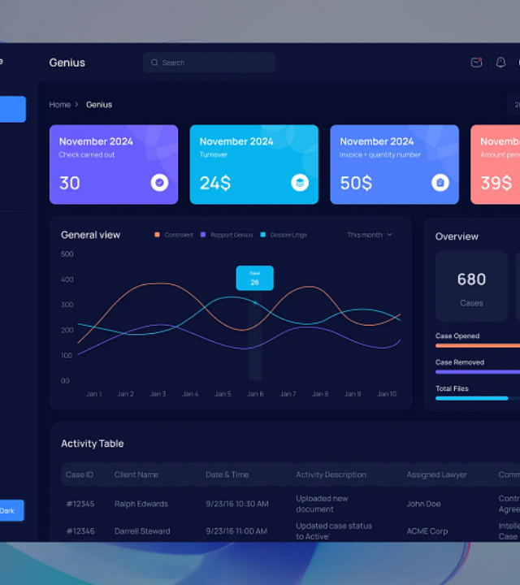
REAL-TIME ANALYTICS
Command Center UI
The dashboard serves as the nerve center for union administrators. It visualizes critical data points such as active membership counts, pending grievances, and financial status in real-time.
Key Benefit: Provides an immediate "pulse check" of the union's health, allowing leadership to make data-driven decisions without digging through spreadsheets.

Slide 5

MEMBER REGISTRY
Digital Roster Management
Move away from physical ledgers. The system maintains a secure, digital database of all members, including roles, departments, and historical join dates.
Instant member lookup and updates.
Role-based access control (Admin vs User).
Zero-latency record management.

Slide 6
GRIEVANCE REDRESSAL
Ticket Tracking: Members submit grievances directly through the portal, categorizing by priority.
Accountability: Every action taken on a grievance is logged to ensure leadership responsiveness.
Status Updates: Issues tracked through stages (Pending, In Progress, Resolved) with full visibility.
Direct Communication: Integrated commenting for clarification and resolution documentation.

Slide 7

AUTOMATED REPORTING
One-Click Compliance
Generating reports for meetings or regulatory compliance often takes hours. Our system automates this completely, allowing for instant generation of:
Financial expenditures and fund allocation.
Voting outcomes and participation rates.
Resolved and pending grievance metrics.

Slide 8
MEASURABLE IMPACT
Efficiency Redefined
80%
By digitizing the union operations, we've seen a dramatic shift in how time and resources are allocated. Leadership can focus on member welfare rather than administrative tasks.
Reduction in Paperwork
100%
3x
Transparency
Faster Resolution

Slide 9
PROJECT ROADMAP
Phase 1
Phase 2
Phase 3
Phase 4
Member Registry & Core Dashboard
Payment & Admin module
Grievance & Update the social activities
Send Sms and email

Slide 10
Union App Registration Experience Overview of
Phage 1
Confidential | Project Overview 2024

Slide 11
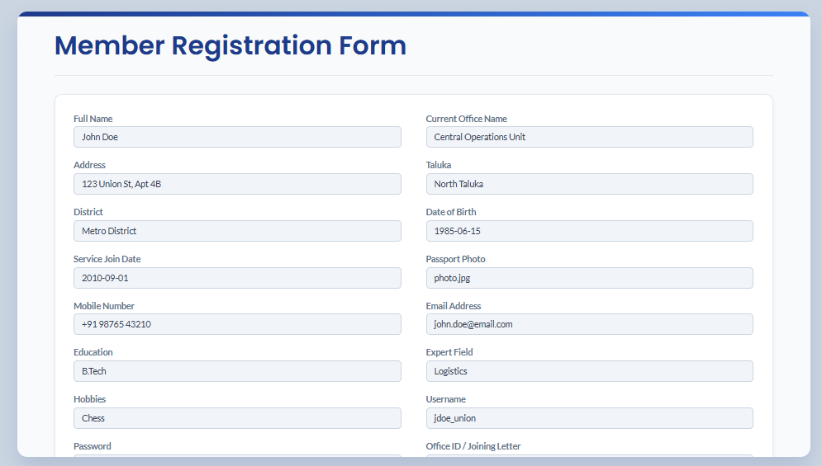
Confidential | Project Overview 2024

Slide 12
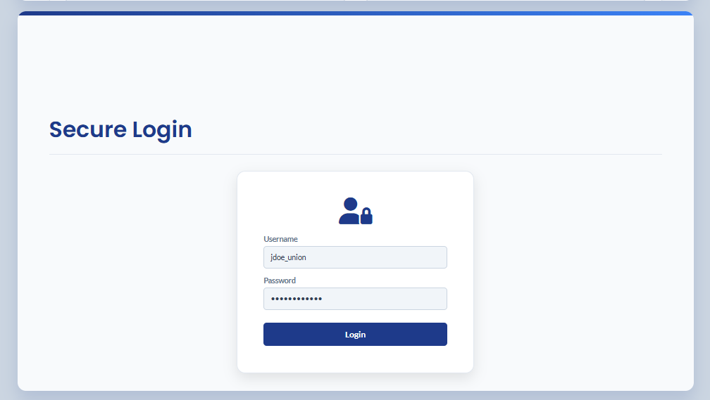
Confidential | Project Overview 2024

Slide 13
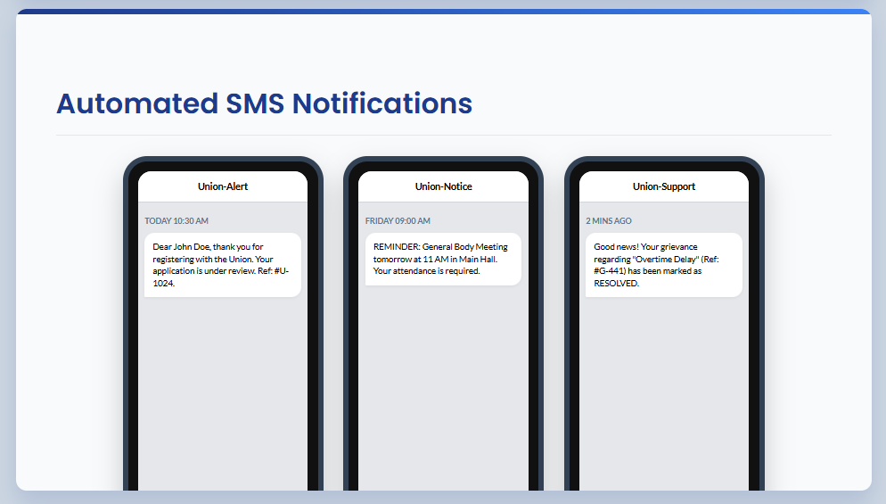
Confidential | Project Overview 2024

Slide 14
MEMBER LIST
ID | Member Name | Office/Department | Designation | Join Date | Status
#U-1024 | Arun Kale | Headquarters / Ops | Senior Analyst | 2015-03-12 | Active
#U-1025 | Swarup Solanke | East Branch / IT | System Admin | 2018-07-22 | Active
#U-1026 | Priya Patel | West Branch / HR | Recruiter | 2023-01-05 | Pending
#U-1027 | David Rossi | Logistics Hub | Coordinator | 2019-11-30 | Active
#U-1028 | Sadhana Kolhe | Finance Dept | Auditor | 2021-05-18 | Active
Showing top records from 1,240 total members

Slide 15


Questions?
Thank you for your attention.
contact@unionsystem.com
www.unionsystem.com

Slide 16



IMAGE SOURCES
https://cdn.dribbble.com/userupload/44075575/file/original-c347f3abbb947b6bf51671f43f83f8c7.webp?resize=752x&vertical=center
Source: dribbble.com
https://images.ui8.net/uploads/preview-7_1737012951188.png
Source: ui8.net
https://static.vecteezy.com/system/resources/previews/016/656/817/large_2x/business-process-abstract-diagram-with-gears-and-icons-workflow-and-automation-technology-concept-photo.jpg
Source: www.vecteezy.com

